Slide 1

QUIZZLET
Bringing Studying to a Whole New Level!
SHEHAN SURESH
ARAVIND SEGU
PRANAV SHARMA
ABHISHEK DHAKLA

Slide 2
What is quizzlet?
Revolutionary platform that provides users access to subject specific quizzes to prepare for upcoming quizzes, tests and exams
Allows both students and teachers to create quizzes for anyone to access and complete

Slide 3
inspiration

Slide 4
DEMONSTRATION

Slide 5
Software components
Java GUI Swing
Compiled on NetBeans
SQL connection to Microsoft Access

Slide 6
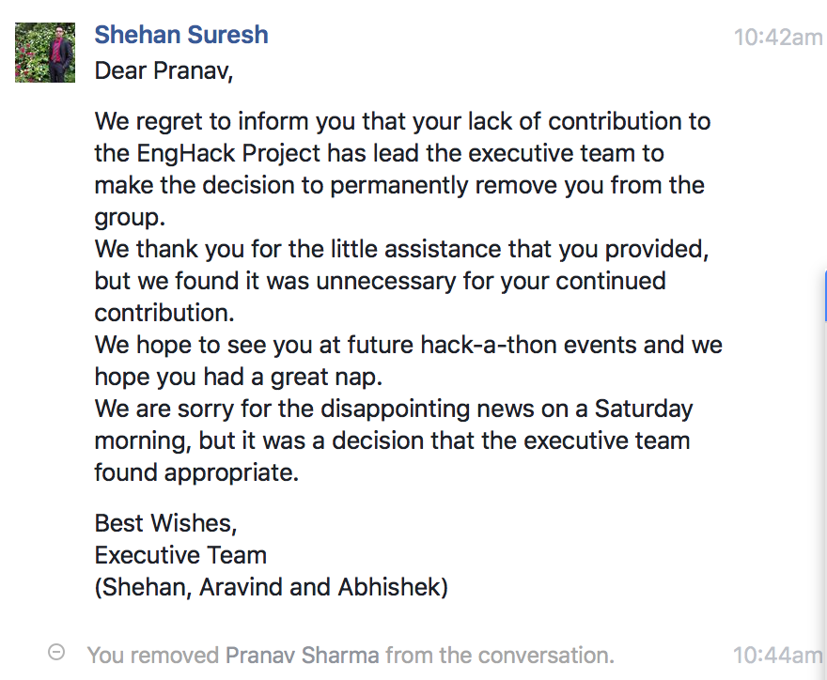
Challenges
Due to unfortunate circumstances the executive team had to let go of a member of the team due to a serious breach of team policies

Slide 7
Serious challenges
Sleep deprivation
Managing windows in the GUI interface
Database storage – (links and connections)

Slide 8
Accomplishments
Successful project at our first hack-a-thon
Learned to use GUI interface
Learned to use SQL to connect to Microsoft Database

Slide 9
Major accomplishment
WE LEARNED A LOT AND HAD FUN!

Slide 10
WHAT’S NEXT FOR QUIZZLET
Adding functionality for separate student and teacher registrations
Allows for teachers to create quizzes and view results for their students

Slide 11
THANK YOU!

